Slide 1
Supervised Machine Learning and Learning Theory
Lecture 20: Foundation models I
November 12, 2024
Reference: https://stanford-cs324.github.io/

Slide 2
Lecture plan
Introduction

Slide 3
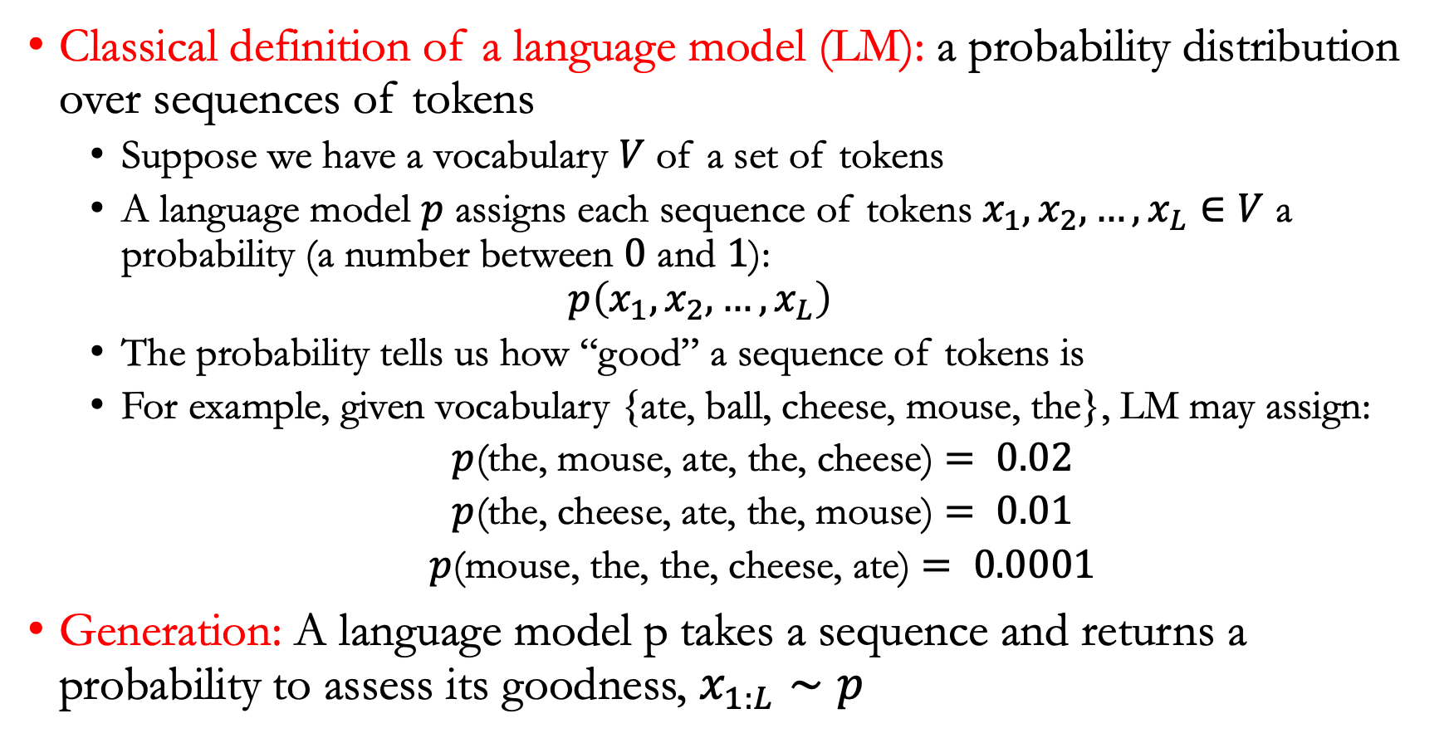
What is a language model?
Classical definition of a language model (LM): a probability distribution over sequences of tokens
  Suppose we have a vocabulary $V$ of a set of tokens
  A language model $p$ assigns each sequence of tokens $x_{1},x_{2},…,x_{L}∈V$ a probability (a number between $0$ and $1$):
  $$p\left(x_{1},x_{2},…, x_{L}\right)$$
  The probability tells us how “good” a sequence of tokens is
  For example, given vocabulary {ate, ball, cheese, mouse, the}, LM may assign:
  $p$(the, mouse, ate, the, cheese) $= 0.02$
  $p$(the, cheese, ate, the, mouse) $= 0.01$
  $p$(mouse, the, the, cheese, ate) $= 0.0001$
Generation: A language model p takes a sequence and returns a probability to assess its goodness, $x_{1:L}∼p$

Slide 4
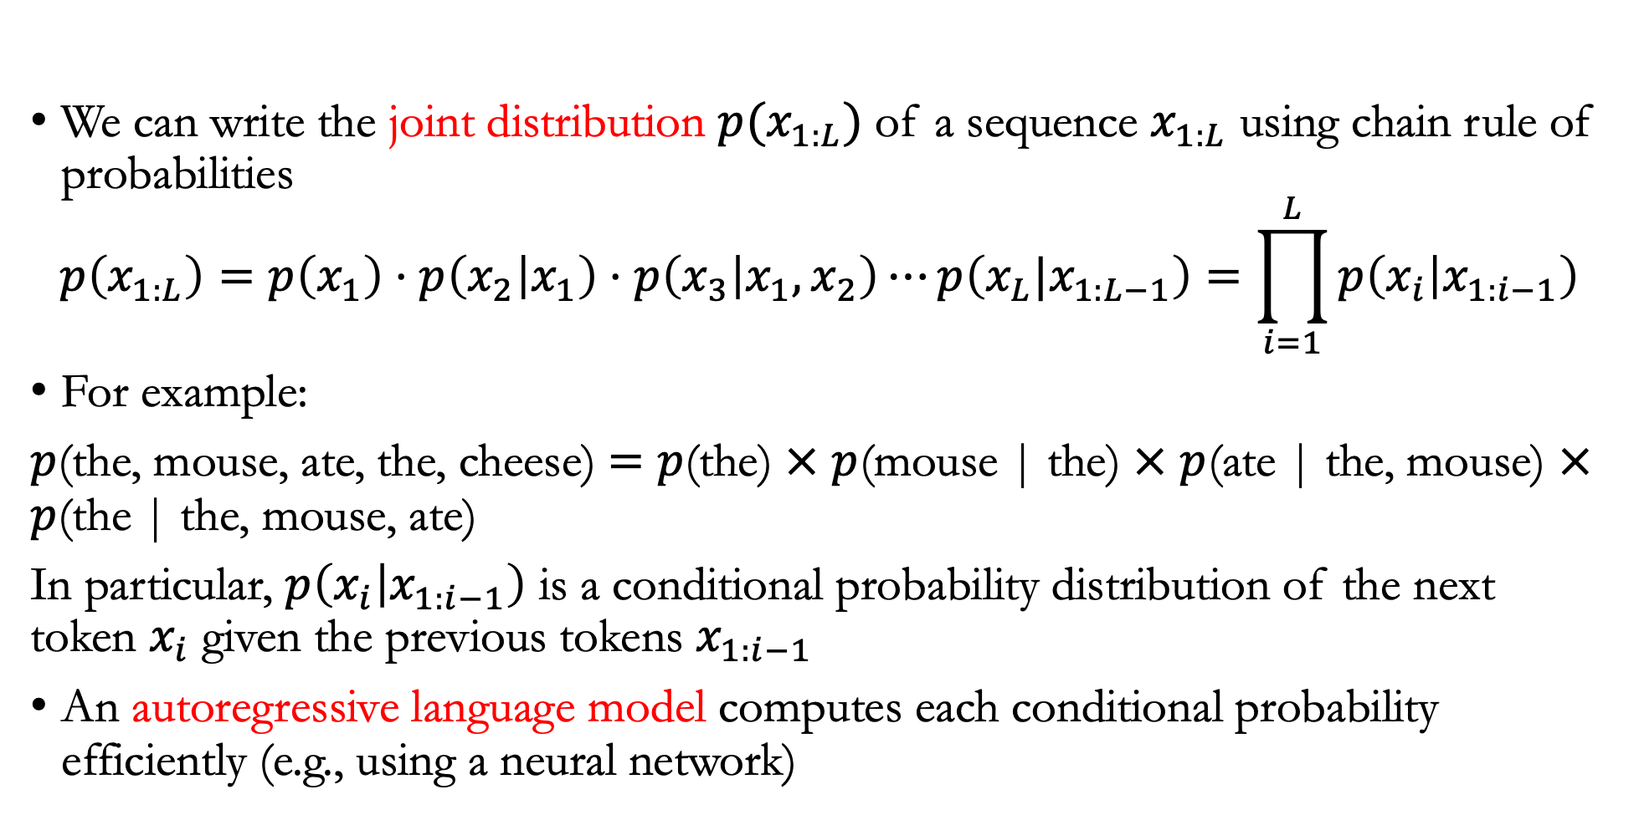
Autoregressive language models
We can write the joint distribution $p(x_{1:L})$ of a sequence $x_{1:L}$ using chain rule of probabilities
$$p\left(x_{1:L}\right)=p\left(x_{1}\right)⋅p\left(x_{2} | x_{1}\right)⋅p\left(x_{3} | x_{1},x_{2}\right)⋯p\left(x_{L}|x_{1:L−1}\right)=\prod_{i=1}^{L}{p\left(x_{i} | x_{1:i−1}\right)}$$
For example:
$p$(the, mouse, ate, the, cheese) $=$ $p$(the) $×$ $p$(mouse | the) $×$ $p$(ate | the, mouse) $×$ $p$(the | the, mouse, ate)
In particular, $p\left(x_{i} | x_{1:i−1}\right)$ is a conditional probability distribution of the next token $x_{i}$ given the previous tokens $x_{1:i−1}$
An autoregressive language model computes each conditional probability efficiently (e.g., using a neural network)

Slide 5
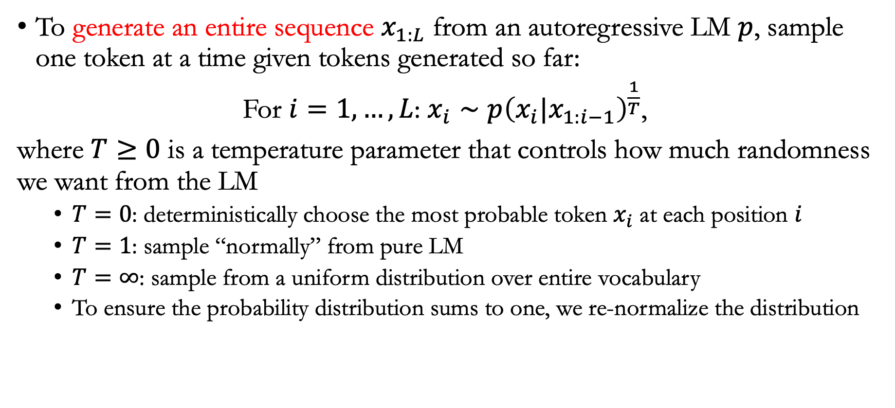
Generation
To generate an entire sequence $x_{1:L}$ from an autoregressive LM $p$, sample one token at a time given tokens generated so far:
For $i=1,…,L$: $x_{i}∼p{\left(x_{i}|x_{1:i−1}\right)}^{\frac{1}{T}}$,
where $T≥0$ is a temperature parameter that controls how much randomness we want from the LM
  $T=0$: deterministically choose the most probable token $x_{i}$ at each position $i$
  $T=1$: sample “normally” from pure LM
  $T=∞$: sample from a uniform distribution over entire vocabulary
  To ensure the probability distribution sums to one, we re-normalize the distribution

Slide 6

Conditional generation
Conditional generation: specify a prefix sequence $x_{1:i}$ (prompt) and sample the rest $x_{i+1:L}$ (completion)
the, mouse, ate $→$ the, cheese
prompt
completion

Slide 7
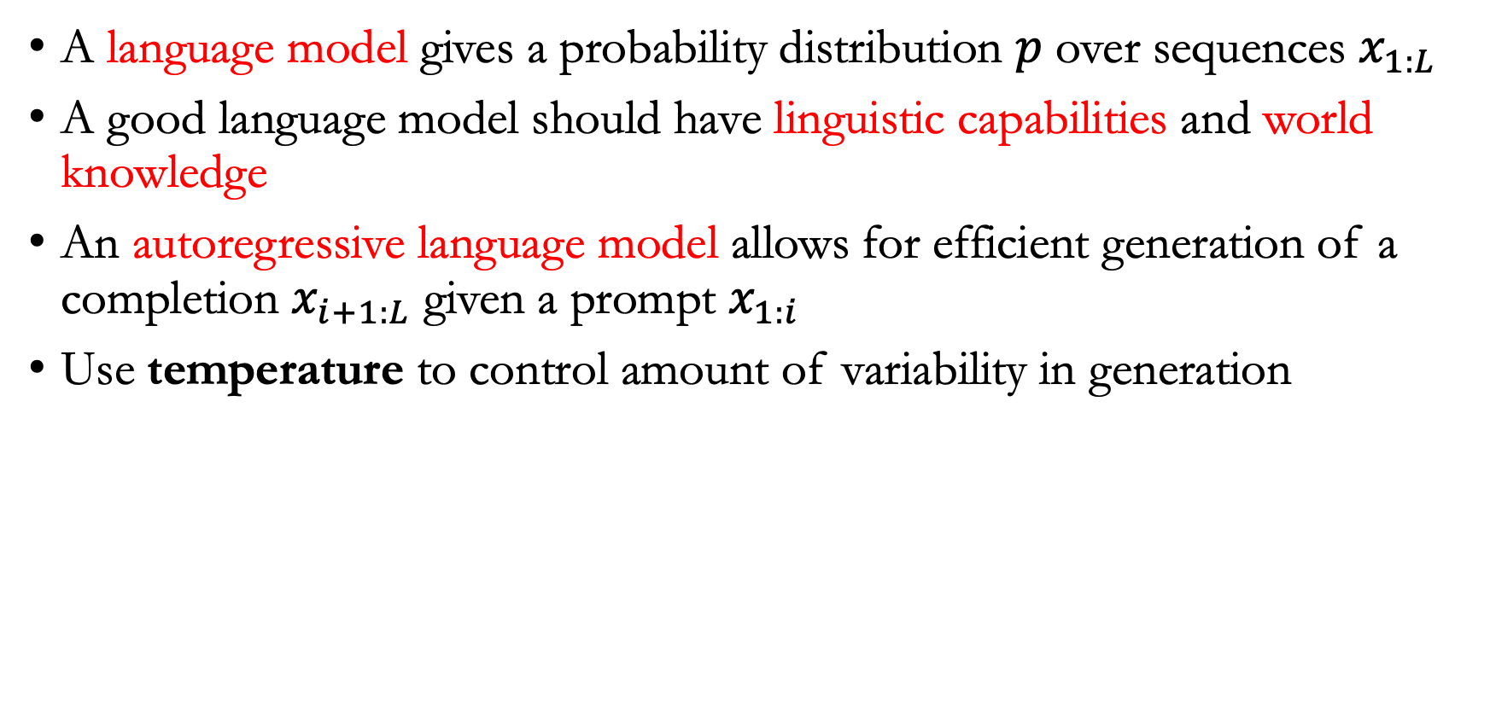
Summary
A language model gives a probability distribution $p$ over sequences $x_{1:L}$
A good language model should have linguistic capabilities and world knowledge
An autoregressive language model allows for efficient generation of a completion $x_{i+1:L}$ given a prompt $x_{1:i}$
Use temperature to control amount of variability in generation

Slide 8
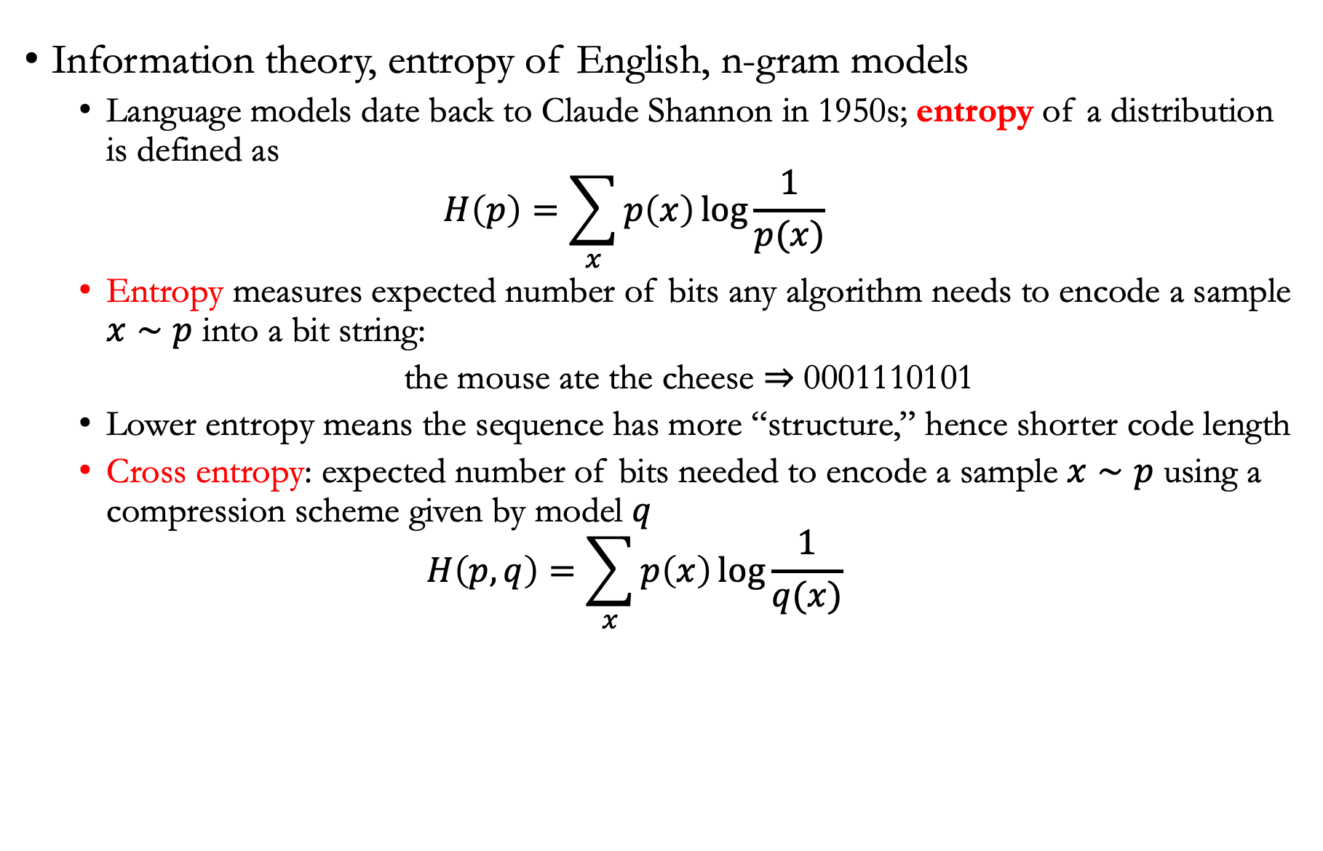
A brief history
Information theory, entropy of English, n-gram models
  Language models date back to Claude Shannon in 1950s; entropy of a distribution is defined as
  $$H\left(p\right)=\sum_{x}{p\left(x\right)\log{\frac{1}{p(x)}}}$$
  Entropy measures expected number of bits any algorithm needs to encode a sample $x∼p$ into a bit string:
  the mouse ate the cheese $⇒$ 0001110101
  Lower entropy means the sequence has more “structure,” hence shorter code length
  Cross entropy: expected number of bits needed to encode a sample $x∼p$ using a compression scheme given by model $q$
  $$H\left(p,q\right)=\sum_{x}{p\left(x\right)\log{\frac{1}{q(x)}}}$$

Slide 9

Entropy
A crucial property is that cross entropy $H\left(p,q\right)≥H\left(p\right)$
Hence we can get better (upper) estimates of entropy $H\left(p\right)$ by constructing better models $q$

Slide 10

N-gram models
N-gram models: the prediction of a token $x_{i}$ only depends on the last $n−1$ characters rather than the full history
$$p\left(x_{i}|x_{1:i−1}\right)=p\left(x_{i}|x_{i−\left(n−1\right):i−1}\right)$$
For example, a trigram ($n=3$) model will define
p(cheese | the, mouse, ate, the) = p(cheese | ate, the)

Slide 11

Neural language model
With a neural network, we represent an N-gram model as
p(cheese | ate, the) = NN(ate, the, cheese)
Examples of NN:
  Recurrent neural networks (RNNs)
  Transformers (GPT-3 used $n=2,048$)

Slide 12
Summary
Language models were first studied in the 1950s, and can estimate the entropy of a corpus
N-gram models are computationally efficient and statistically inefficient
Neural language models are statistically efficient but computationally inefficient

Slide 13
Lecture plan
Capabilities

Slide 14
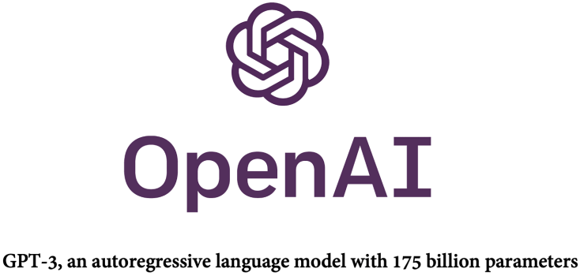
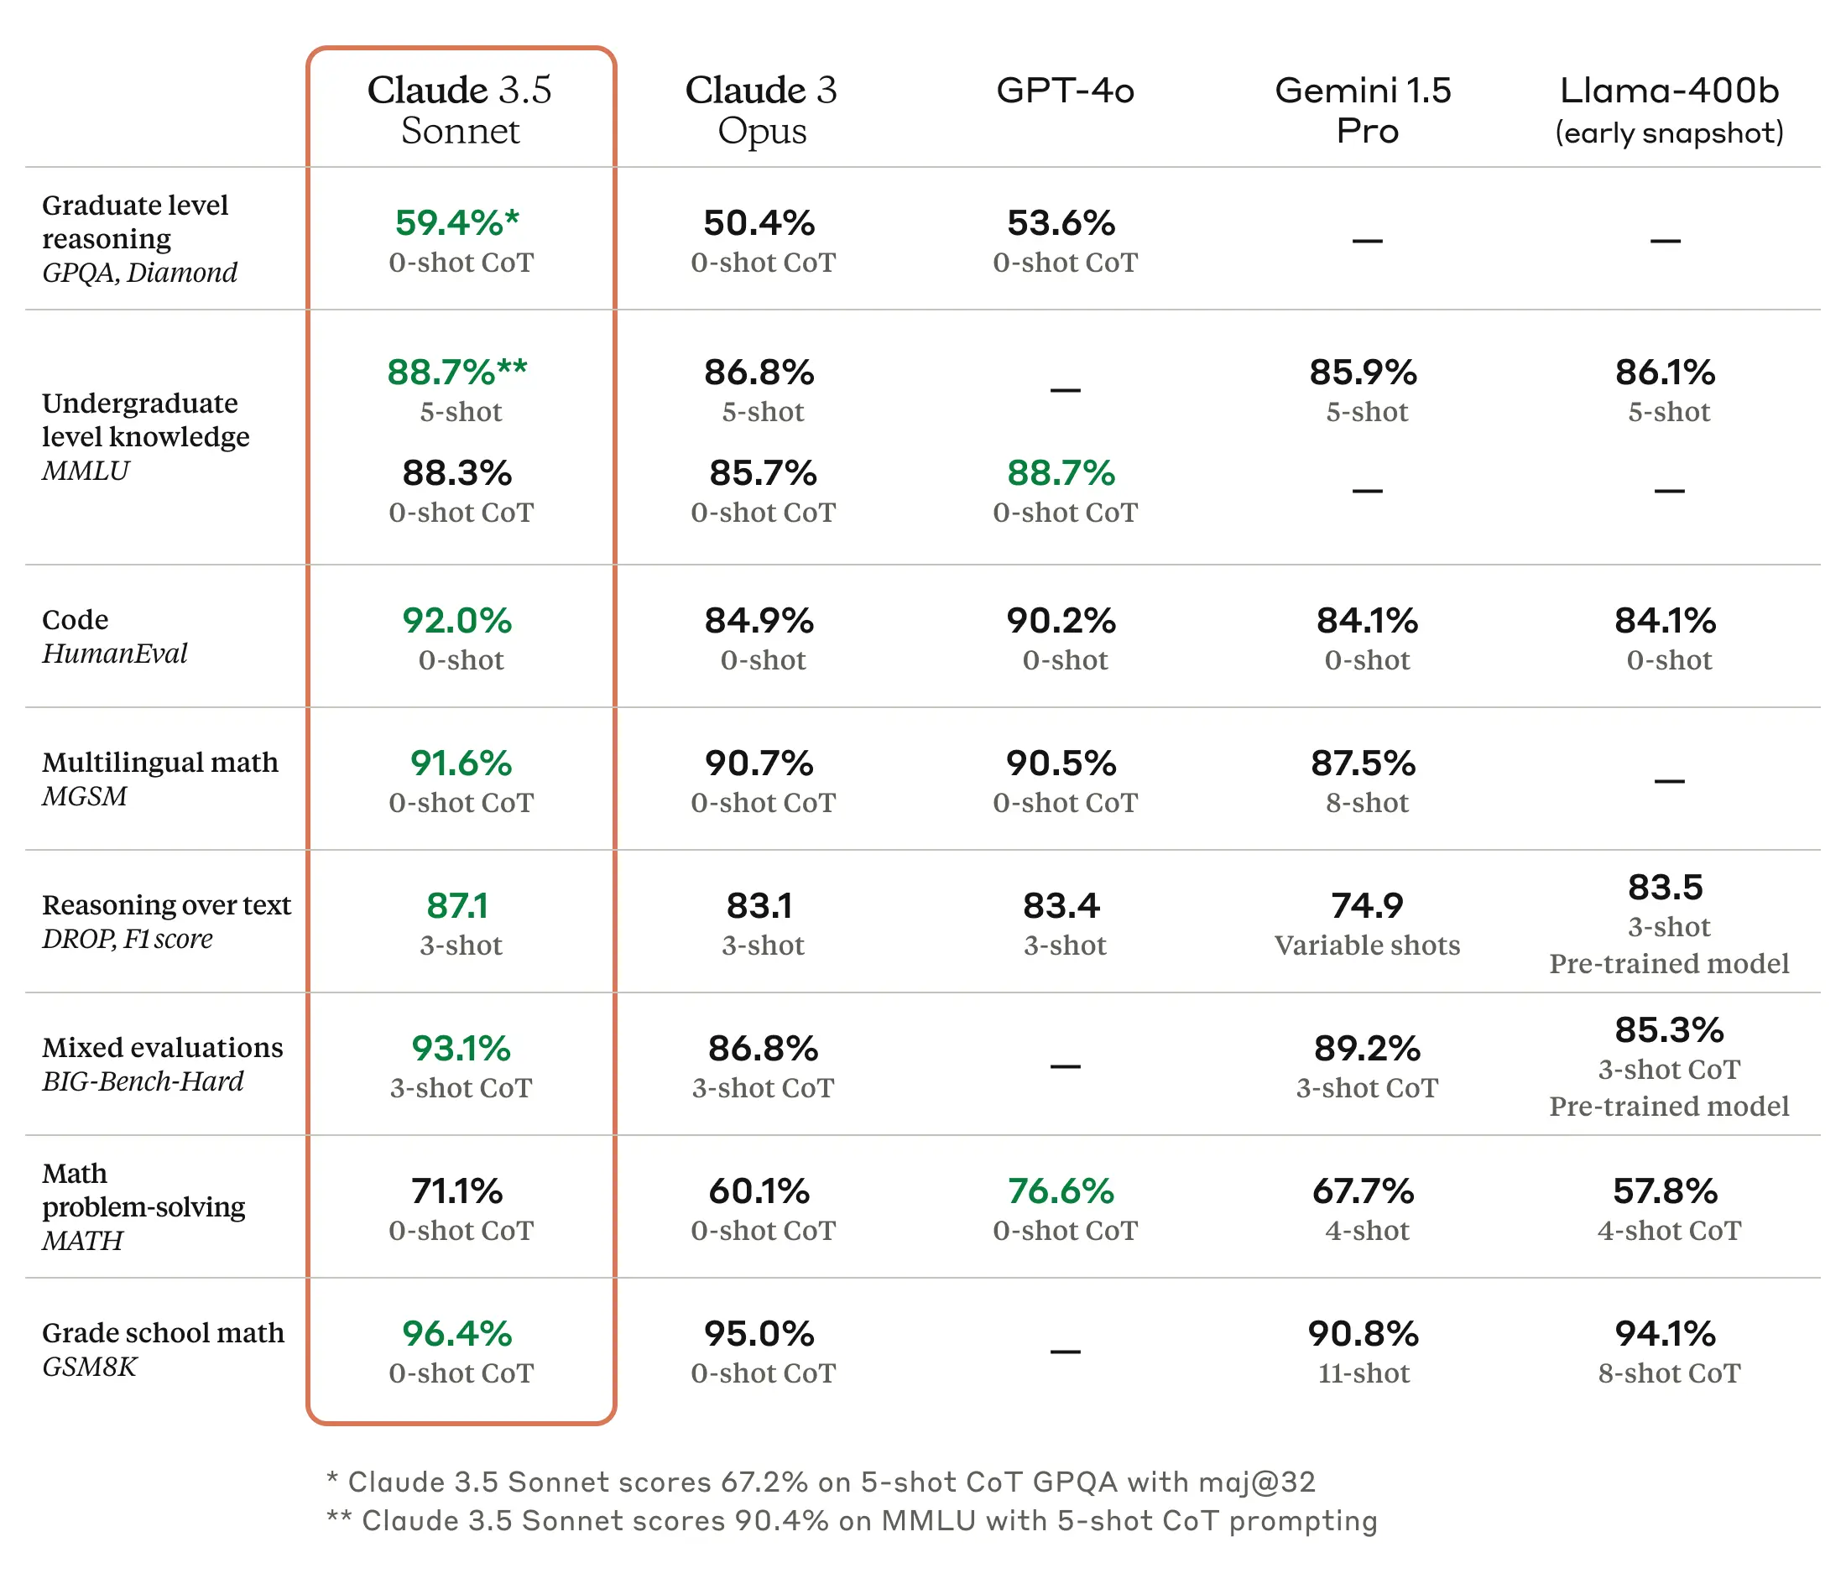
GPT-3
What is GPT-3?
  It was trained as a language model to predict the next word
  Even without “trying,” GPT-3 does a reasonable job on average at a broad range of NLP tasks
  For any particular NLP task (e.g., question answering), adapt GPT-3 is a good solution in principle

Slide 15
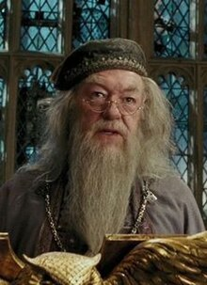
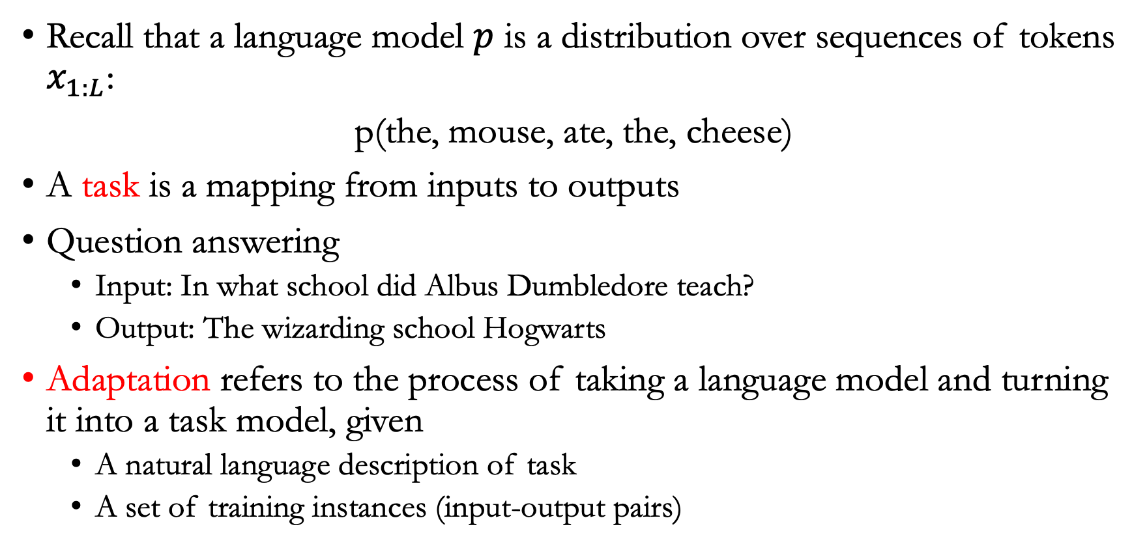
Adaptation
Recall that a language model $p$ is a distribution over sequences of tokens $x_{1:L}$:
p(the, mouse, ate, the, cheese)
A task is a mapping from inputs to outputs
Question answering
  Input: In what school did Albus Dumbledore teach?
  Output: The wizarding school Hogwarts
Adaptation refers to the process of taking a language model and turning it into a task model, given
  A natural language description of task
  A set of training instances (input-output pairs)

Slide 16
Training
Train a new model that maps inputs to outputs, by
  Creating a new model that uses the language model as features (probing)
  Starting with the language model and updating it based on training instances (fine-tuning)
  Lightweight fine-tuning: Adapters, low-rank adaptation

Slide 17
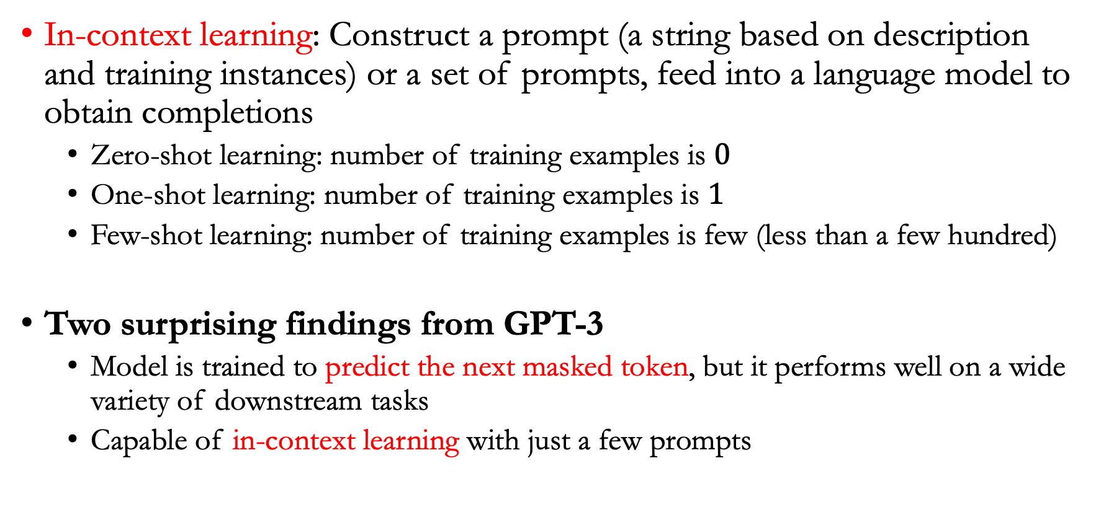
Prompting
In-context learning: Construct a prompt (a string based on description and training instances) or a set of prompts, feed into a language model to obtain completions
  Zero-shot learning: number of training examples is $0$
  One-shot learning: number of training examples is $1$
  Few-shot learning: number of training examples is few (less than a few hundred)
Two surprising findings from GPT-3
  Model is trained to predict the next masked token, but it performs well on a wide variety of downstream tasks
  Capable of in-context learning with just a few prompts

Slide 18
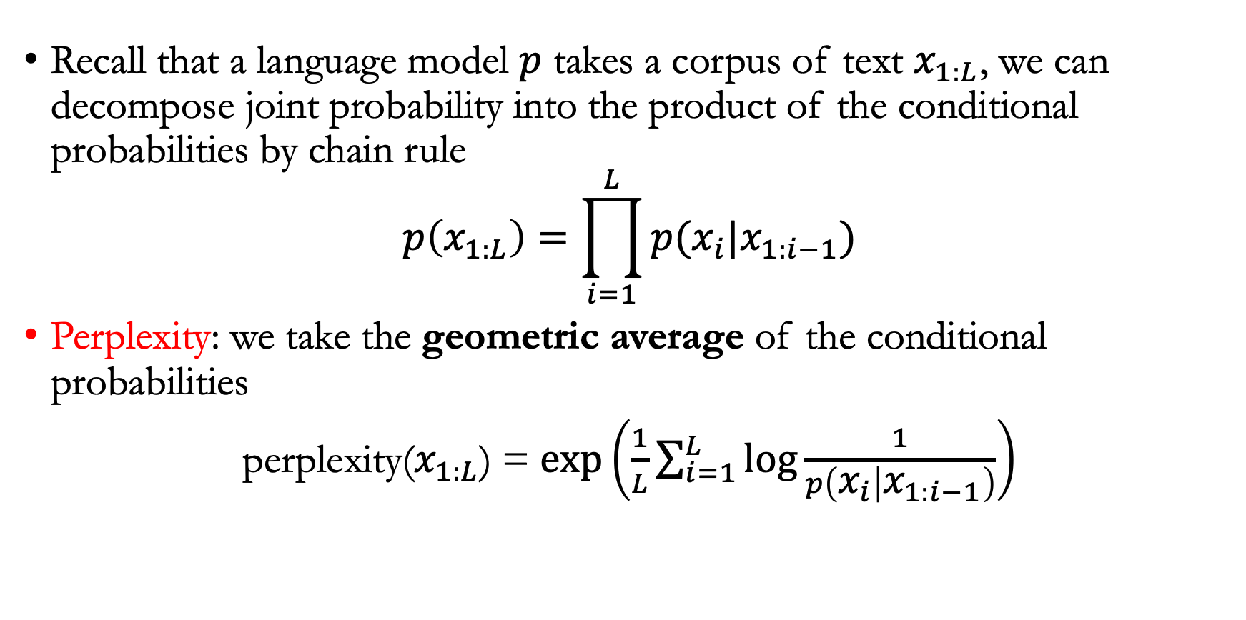
Language modeling
Recall that a language model $p$ takes a corpus of text $x_{1:L}$, we can decompose joint probability into the product of the conditional probabilities by chain rule
$$p\left(x_{1:L}\right)=\prod_{i=1}^{L}{p(x_{i}|x_{1:i−1})}$$
Perplexity: we take the geometric average of the conditional probabilities
perplexity($x_{1:L}$) = $\exp\left(\frac{1}{L}\sum_{i=1}^{L}{\log{\frac{1}{p\left(x_{i} | x_{1:i−1}\right)}}}\right)$

Slide 19
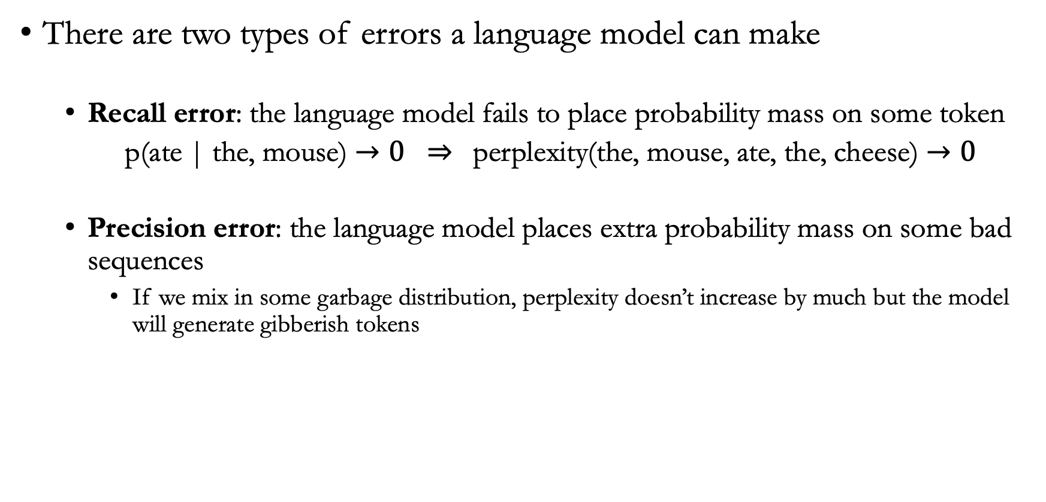
Perplexity
There are two types of errors a language model can make
  Recall error: the language model fails to place probability mass on some token
  p(ate | the, mouse) $→0 ⇒$ perplexity(the, mouse, ate, the, cheese) $→0$
  Precision error: the language model places extra probability mass on some bad sequences
    If we mix in some garbage distribution, perplexity doesn’t increase by much but the model will generate gibberish tokens

Slide 20
Penn Tree Bank
Penn Tree Bank is a classical dataset in NLP: https://catalog.ldc.upenn.edu/LDC99T42
Syntactic parsing: automated analysis of syntactic structure of natural language
  Identify the syntax structure of a sentence according to English grammar
Part-of-speech tagging: marking up a word in a text as corresponding to a particular part of speech
  For example, identify words as nouns, verbs, adjectives, adverbs, etc

Slide 21
LAMBADA
Task: Predict the last word of a sentence
Motivation: Solve the task requires long-range dependencies
Example:
  Prompt: Alice was friends with Bob. Alice went to visit her friend ___
  Answer: Bob

Slide 22
HellaSwag
Motivation: Evaluate a model’s ability to perform commonsense reasoning
Task: Choose the most appropriate completion for a sentence from a list of choices
Adaptation: score each candidate answer with a language model and predict the “most likely” one
  Prompt: Making a cake: Several cake pops are shown on a display. A woman and girl are shown making the cake pops in a kitchen. They ${answer}
  Answer: one of
    bake them, then frost and decorate
    taste them as they place them on plates
    put the frosting on the cake as they pan it
    come out and begin decorating the cake as well

Slide 23
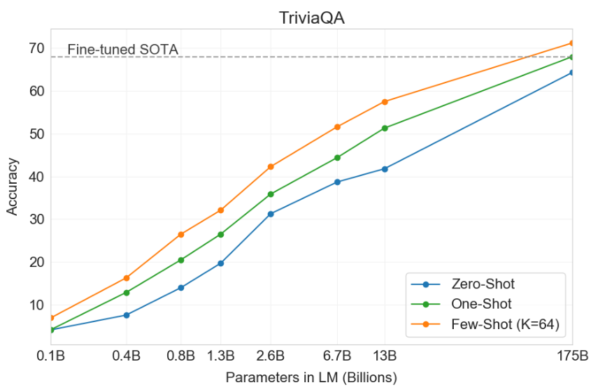
Question answering
Input: A question, Output: an answer
TriviaQA:
  Task: given a trivia question, generate the answer
Adaptation:
  Q: “Harry Potter” is perhaps the most famous fiction by which author?
  A: J. K. Rowling
Both increasing model size and number of prompts help

Slide 24
WebQuestions
Task: answer questions
Dataset collected from Google search queries, initially created for question answering on knowledge bases
Adaptation
  Input: In what school did Albus Dumbledore teach?
  Output: The wizarding school Hogwarts
NaturalQuestions: A related dataset (with long-form answers)
  https://huggingface.co/datasets/google-research-datasets/natural_questions

Slide 25
Translation
Task: Translate a sentence in a source language (e.g., German) to sentence in a target language (e.g., English)
Evaluation: Since there are multiple possible translations, the (automatic) evaluation metric is BLEU
  Captures a notion of n-gram overlap
  https://en.wikipedia.org/wiki/BLEU

Slide 26
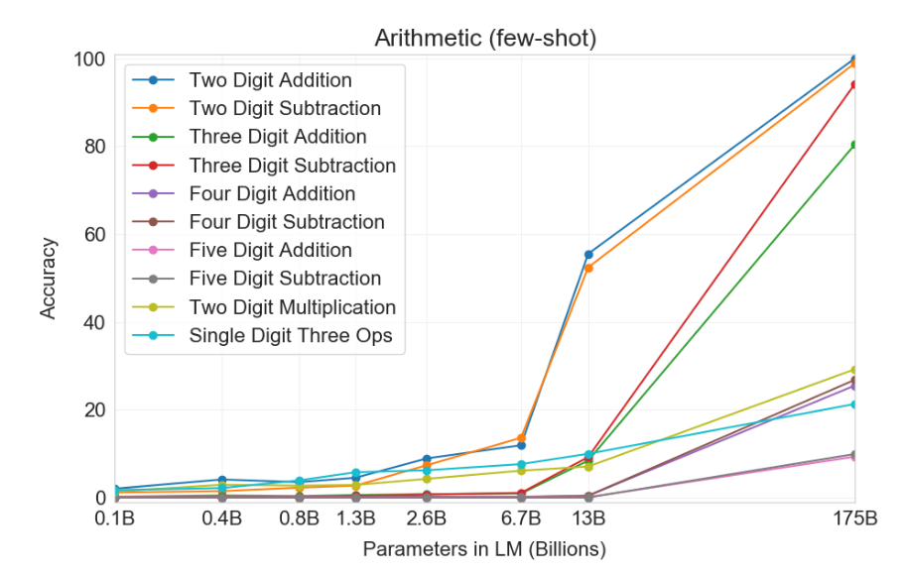

Arithmetic tasks
GPT-3 is a language model, but we can evaluate it on a range of more abstract reasoning tasks
Task: perform arithmetic
  Example: $a^{2}+ab+b^{2} (mod p)$, where $p$ is a prime number

Slide 27
News article generation
Task: given title and subtitle, generate a news article
Evaluation: human rated articles based on how likely the article is written by a machine

Slide 28
Other tasks
SWORDS: lexical substitution, where the goal is to predict synonyms in the context of a sentence
Massive multitask language understanding: 57 multiple-choice problems spanning mathematics, US history, computer science, etc
TruthfulQA: question answering dataset that humans would answer falsely due to misconceptions

Slide 29
Summary
GPT-3 was evaluated on a wide range of standard NLP benchmarks and on arithmetic tasks, etc
Increasing model size and number of examples help performance
Why does GPT-3 work well? No one knows

Slide 30
Common crawl
Data behind training large language models
  Common crawl: a nonprofit organization that crawls the web and provides snapshots free to public
  Representation: large-scale data still has uneven representation over population
  Internet data over represents younger uses from developed countries
  GPT-2 is trained based on Reddit: 67% of Reddit users in the US are men, 64% between 18 – 29 years old

Slide 31
WebText (and OpenWebText)
WebText was used to train GPT-3
However, Web text can contain toxic content
  4.3% of WebText from OpenAI has toxicity score at least 50%

Slide 32
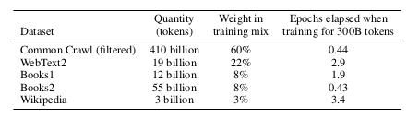
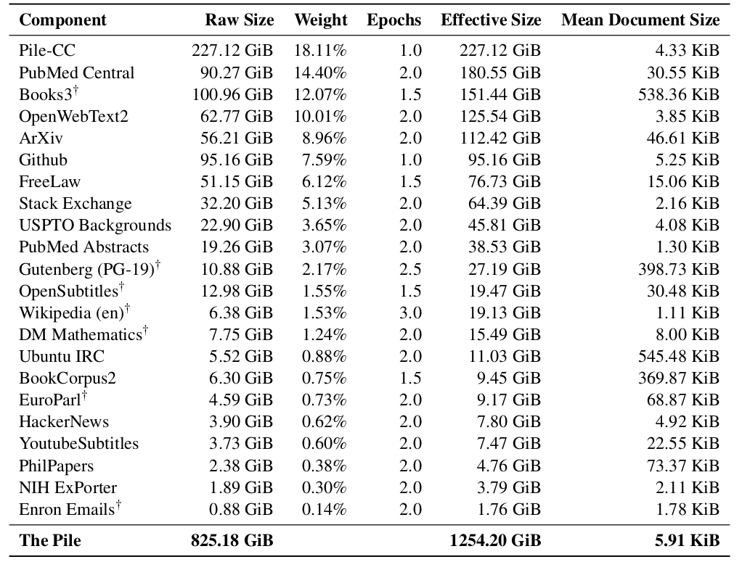
GPT-3 dataset
Summary
  Total amount of data on the Web is massive
  Training on all of it doesn’t work well
  Curating high-quality datasets is promising
  Important to carefully document and inspect the datasets

Slide 33
Announcements
We have scheduled the follow-up meetings regarding the project proposals
We’ll schedule another around of meetings to check in before the final project presentations
We plan to release homework 4 on Friday (give a few days of break between midterm and next homework)
HW3 should be graded by end of this week
Questions & comments always welcome!
Further reading
  https://cdn.openai.com/better-language-models/language_models_are_unsupervised_multitask_learners.pdf
  https://arxiv.org/pdf/2407.21783

