Slide 1
Supervised Machine Learning and Learning Theory
Lecture 15: The vanishing gradients problem
October 25, 2024

Slide 2
Lecture plan
Deriving the backward pass
Vanishing gradient

Slide 3
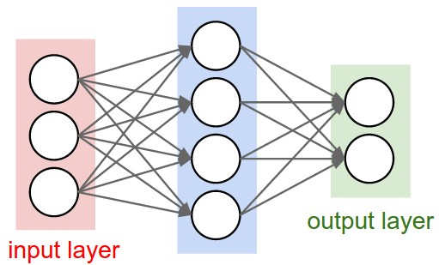
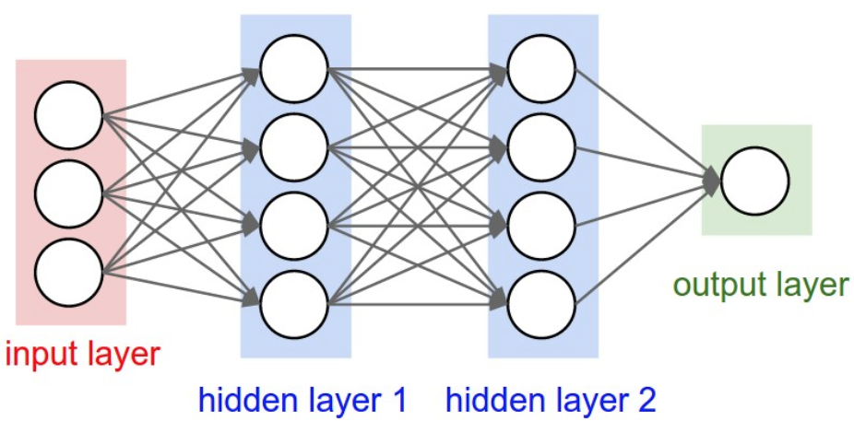

The vanishing gradient problem
To illustrate the problem, we will revisit our MNIST example
  Network architecture: $[784, 30, 10]$
  Network architecture: $[784, 30, 30, 10]$

Slide 4

Illustration with two hidden layers
Compare the magnitude of the gradient at both hidden layers
  Remark: Both hidden layers have the same width $[784, 30, 30, 10]$

Slide 5

Illustration with three hidden layers
Three hidden layers
  Network architecture: $[784, 30, 30, 30, 10]$

Slide 6

Illustration with four hidden layers
Let’s look at a neural net with four hidden layers
  Network architecture: $[784, 30, 30, 30, 30, 10]$

Slide 7
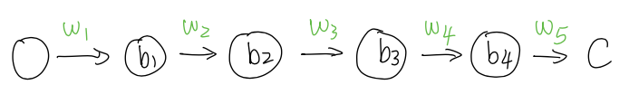


Explanation: why?
For simplicity, consider a neural network with only a single neuron in every hidden layer
The final output $C$ given some input $x$ is equal to:
  $w_{i}$ is weight at layer $i$; $b_{i}$ is the output of layer $i$

Slide 8

Chain rule
We’ll derive the derivative $\frac{∂C}{∂b_{1}}$ with chain rule
Setup
  $w_{i}$ is weight at layer $i$
  $z_{i}$ is the input to layer $i$
  $b_{i}$ is the output of layer $i$

Slide 9

Chain rule
Setup
  $w_{i}$ is weight at layer $i$
  $z_{i}$ is the input to layer $i$
  $b_{i}$ is the output of layer $i$
Fact
  $z_{i}=w_{i}b_{i−1}$
  $b_{i}=σ(z_{i})$

Slide 10
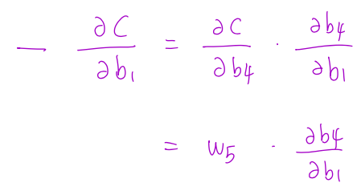
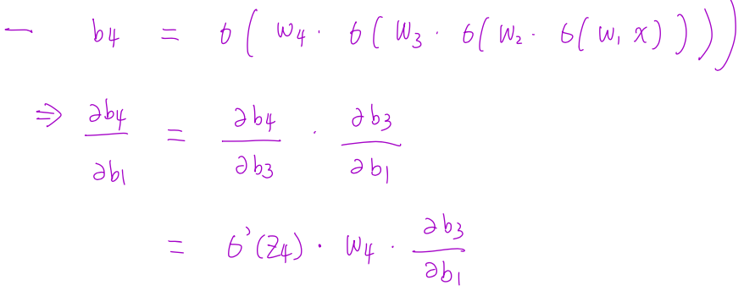
Chain rule
First chain rule:
Second chain rule:

Slide 11
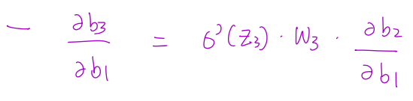
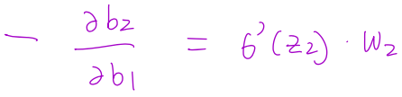
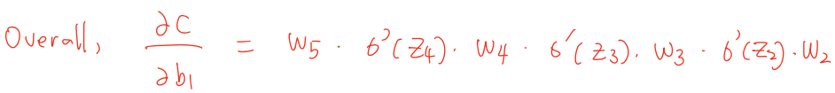
Chain rule
Third chain rule:
Fourth chain rule:
Combining all four chain rules together:

Slide 12
Fix: Add residual connections
Residual connection
Residual connection stabilizes the gradient
Layer normalization: Normalize the intermediate representations to have mean zero and isotropic covariance matrix

